Slide 1
DTPM SIG
01/11/2023
Notes:
Meeting minutes are in the speaker notes for the relevant slide

Slide 2
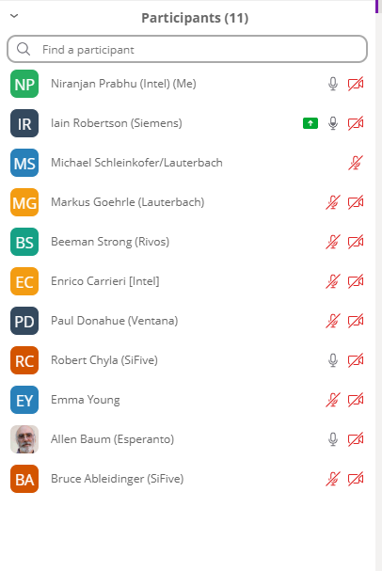
Agenda
Disclosures
Charter
TG Status
Debug, Nexus
Maintenance
Proposed Focus Areas
Gap Analysis Backlog
Discussion
Future meetings
AOB
Notes:
Attendees: see screenshot on the agenda slide

Slide 3
Disclosures
Video link

Slide 4
Only RISC-V Members May Attend
Non-members are asked to please leave except for Joint Working Groups (JWG).
Members share IP protection by virtue of their common membership agreement. Non-members being present jeopardizes that protection. Joint working groups (JWG) agree that any IP discussed or worked on is fully open source and unencumbered as per the policy.
It is easy to become a member. Check out riscv.org/membership
If you need work done between non-members or or other orgs and RISC-V, please use a joint working group (JWG).
used to allow non-members in SIGs but the SIGs purpose has changed.
Please put your name and company (in parens after your name) as your zoom name. If you are an individual member just use the word “individual” instead of company name.
Non-member guests may present to the group but should only stay for the presentation. Guests should leave for any follow on discussions.

Slide 5
Antitrust Policy Notice
RISC-V International meetings involve participation by industry competitors, and it is the intention of RISC-V International to conduct all its activities in accordance with applicable antitrust and competition laws. It is therefore extremely important that attendees adhere to meeting agendas, and be aware of, and not participate in, any activities that are prohibited under applicable US state, federal or foreign antitrust and competition laws.
Examples of types of actions that are prohibited at RISC-V International meetings and in connection with RISC-V International activities are described in the RISC-V International Regulations Article 7 available here: https://riscv.org/regulations/
If you have questions about these matters, please contact your company counsel.

Slide 6
Collaborative & Welcoming Community
RISC-V is an open ISA enabling a new era of processor innovation through open standard collaboration. Born in academia and research, RISC-V ISA delivers a new level of extensible software and hardware freedom on architecture, paving the way for the next 50 years of computing design and innovation.
We are a transparent, collaborative community where all are welcomed, and all members are encouraged to participate. We are a continuous improvement organization. If you see something that can be improved, please tell us. help@riscv.org
We as members, contributors, and leaders pledge to make participation in our community a harassment-free experience for everyone.
https://riscv.org/community/community-code-of-conduct/

Slide 7
Conventions
For one hour meetings, please start at 5 after the start time in order to allow people going to other meetings have time for a short break between meetings. 30 minute meetings start on time.
Unless it is a scheduled agenda topic, we don’t solve problems or detailed topics in most meetings unless specified in the agenda because we don’t often have enough time to do so and it is more efficient to do so offline and/or in email. We identify items and send folks off to do the work and come back with solutions or proposals.
If some policy, org, extension, etc. can be doing things in a better way, help us make it better. Do not change or not abide by the item unilaterally. Instead let's work together to make it better.
Please conduct meetings that accommodates the virtual and broad geographical nature of our teams. This includes meeting times, repeating questions before you answer, at appropriate times polling attendees, guide people to interact in a way that has attendees taking turns speaking, …
Where appropriate and possible, meeting minutes will be added as speaker notes within the slides for the Agenda

Slide 8
Charter
Full verbiage is here. Key points:
The goal for the DTPM SIG shall be to define a strategy to establish specifications and guidelines for the interfaces, transports, and other pieces of the SoC infrastructure
The DTPM SIG shall focus on the following areas:
Standard programming interface to aid interoperability
Protocols and formats for debug/trace/performance-monitoring encapsulation
Unified security architecture for debug/trace
Cables and connectors
Debug, Trace, and SoC performance monitoring features
The DTPM SIG shall work on a gap analysis by starting with a lay of the land review on RVI debug, trace, SoC performance-monitoring capabilities

Slide 9
TG Status - Debug
Still shooting for Q2 for ratification
Several minor follow-on items deferred to v1.1:
#562, let the debugger flush caches when there is no program buffer
#390, optionally don't reset debug CSRs during reset

Slide 10
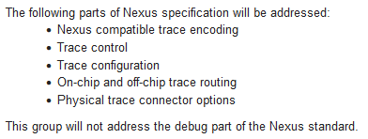
N-Trace Status (part 1)
Nexus TG was following full, ambitious and wide agenda:
Nexus TG Group clearly wants to ratify all ‘components’ together
It was key ambition to provide full end-to-end-trace, consistent and integrated solution
During development of this standard, I’ve seen several implementations based on preliminary material.
Trace Connectors (‘practically frozen’)
Based on updated (by Nexus TG request!) MIPI standard (+ small Arm-compatible extension).
Fully compatible with RISC-V Debug Connectors (pure extensions).
Unchanged for long time (some formatting and unification changes still possible).
Lauterbach (key player in high-end trace) contributed significantly. Myself as well (when I was with IAR there).
Several trace probe vendors OK-ed the spec already
Robert Chyla

Slide 11
N-Trace Status (part 2)
Official TG agenda (as a reminder …) in the upper right corner …
Control, Configuration, On-chip, off-chip trace routing (‘practically frozen’)
It was the biggest ‘headache’ from many reasons:
Desire to make it 100% shared with E-Trace
E-Trace in meantime went through data trace ratification (I on purpose slow-down on N-Trace MESSAGES to NOT create ‘mixed feeling’ in community).
Agreed (but a bit late …) discussion/decision to spit into separated IP blocks (for easier SoC integration).
A lot of ADOC formatting, housekeeping and learning curve (diagrams, tables, etc.).
Original, donated specification was NOT designed as guide for implementation, so a lot of clarifications were necessary.
No significant changes/notes for some time
Markus from Lauterbach from tools perspective and Iain from E-Trace angle were contributing and validating a lot (big thanks ☺!)
Some new active members (from IP side) as well (more clarifications).
This is a standard for ‘years to come’, so should NOT be rushed.
Messages (‘in working state’)
It was pushed as ‘last-item’ as it is easiest and least ‘externally sensitive’ and ‘easy to agree’ part of specification.
Messages (and fields) are ‘taken’ from Nexus standard ‘as-is’.
Reference encode and decoder as well as preliminary ADOC with messages were NOT changed for long time.
Reference code included ‘machine-readable’ pseudo-formal spec of RISC-V messages (fully Nexus compliant!)
Now ADOC is being ‘converted’ into RISC-V Style PDFs
Some clarifications are still needed, but basically this is fully ‘defined’ by Nexus, reference encoder/decoder/dumper and ADOC as well.
Nexus is flexible and extensible format, but with ‘default profile’, it provides better than ‘good enough’ compression.
Robert Chyla

Slide 12
N-Trace Status (part 3)
Official TG agenda (as a reminder …) in the upper right corner …
Proof of Concept and Reference implementation[s]
Original version of trace control (so called ‘version 0’ has several implementations in silicon – it is NOT only SiFive).
Current version can be considered as ‘extension’ of original donated by SiFive
Reference encode/decoder provided long time ago (when I was with IAR).
That reference was used by others to do own N-Trace implementations.
Recently slightly refreshed to run test used by E-Trace during ratification.
TODO: Need to find a way to not duplicate ELF files from E-Trace (update script …).
Amount of work left and formal steps
I estimate 3 to 4 weeks of work (TG is meeting weekly) to have ‘message PDF’ completed.
Other PDFs are ‘practically frozen’, so we can focus. Vice chair (Jay from NXP is an expert on Nexus messages).
I created infrastructure to generate PDFs easily.
With so good compressions, we will NOT went into area of optimizing encoding too much. It will provide some gain, but it is NOT needed.
We can always create another revision (only addressing more optimal encoding)
I am preparing formal ‘Ratification Plan’ (only recently I have to admit – but planning principles were also evolving …)
Preparing a plan sooner would NOT make much difference as key components were ‘floating’ – now there is no ‘unknowns’ ahead.
I am personally far from pushing for ‘impossible deadline’, but I am rather seeking completeness, uniformity and excellence.
Again – this is a spec for years to come!
I want to seek formal ratification (of entire package) in Q1 2023
This is non-ISA specification, so formal steps are easier and shorter!
IMO there is no need for any waivers (reference implementations both in SW and in IP are already available)
Robert Chyla

Slide 13
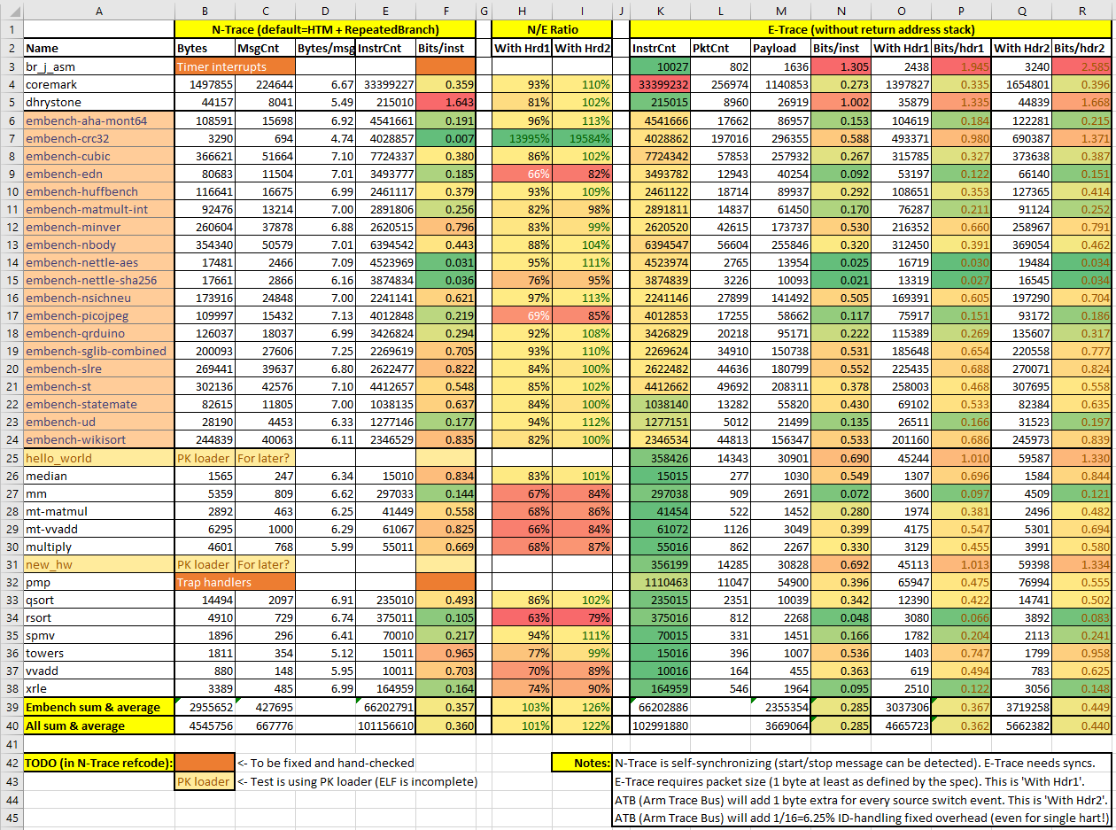
Trace Compression Comparison (recent)
These are Preliminary!
I included row/column for easier reference.
‘embench-’ tests are real-life programs, but average is nearly the same
Average is about 0.36 bits/instr, (both E-Trace and N-Trace). It means that 1GHz core with 1 IPC, will produce 360Mbps of trace (45MB/s).
This bandwidth is EXCELLENT!
Mictor connector is capable of 12.6Gbps bandwidth!
MIPI20 connector has 1.6Gbps (4 cores!)
IMPORTANT: Both N-Trace and E-Trace on ‘default’ settings and both will do better using return stack compression.
Some unusual Bits/inst values should be looked at and understood.
I want to trace full Linux boot – this will be ultimate ‘real-life’ program!
Compression is APP and compiler-dependent ☹ (lower IPC, the better!).
Notes:
Preliminary data from Robert

Slide 14
Maintenance
eTrace:
Clarifications on push/pop support for data trace agreed with requestor (Seagate)
Examples added to section 4.3 and pull request made
No functional change
Not merged to main yet. Wait for…
Need to remove register descriptions and cross-reference common-control when it is frozen
Corner-case bug in reference encoder model found, fixed, regressed and merged

Slide 15
Proposed Next Focus Areas
Trace
eTrace packet encapsulation for transport
I propose we form a task group to define this
eTrace vector extension support
I believe nothing is needed for instruction trace
Data trace may require additional packet formats – needs further discussion
Competitive analysis of debug/trace features from different architectures
Any volunteers?
Debug Authorisation framework
Some discussions underway…
Various debug levels End-User, Expert or OEM, etc.
How do we authorize different levels?
Root of trust being established to debug and identify if debug is enabled on a platform
What can be part of debug vs what cannot be part of debug?
Virtualization for trace to memory
Notes:
No disagreement with proposal to start encapsulation TG. Iain to discuss with Ved/Gadge
Markus: are we looking into MIPI Encapsulation Specification (TWP) for Packet Encapsulation
Enrico: Specification is available and there is agreement with RISC-V to share specifications
Markus: this will be the TWP protocol and being used by others
Enrico: MIPI TWP: https://www.mipi.org/specifications/twp
Iain: Will consider the MIPI spec for the TG
Markus: Emphasis will be for TWP and is being used for many years
Enrico: can help with legal issues if required
Iain: There maybe licensing issues
Enrico: can talk through those issues and have MIPI clarify the details and take away the barrier
Niranjan: Do we need to have a separate section for Vector Instructions
Iain: Extensions are supported in the spec and hence no need to clarify more at this time
Iain: Data trace is
Paul: Vector load can load 100s of independent element and there is a page fault; There is possibility of partially completed instruction
Iain: There will be need to clarify details around this topic and will happen offline

Slide 16
Gap AnalysisBacklog
Trace
cycle accurate
trace to memory
Performance counting
Collaborate with Perf Analysis SIG as required
Remote Telemetry
Self hosted debug
Debug spec, post ratification:
Vector extension impact
Couple of minor issues deferred (see slide 9)
Alternatives to GDB with multi-core support
Notes:
Beeman: Perf Analysis SIG looking at ISA but will need more collaboration with DTPM when extending to SoC
Robert: Self hosted debug is being discussed in Debug TG (Tim & Paul)
Paul: There is a demo but need more information on requirements
Robert, Iain: Need to have more clarity on what is being discussed and bring it into DTPM SIG

Slide 17
Future Meetings / AOB
Monthy from now on – 2nd Wednesday of each month
AOB

Slide 18
Thank You

